Slide 1
Basics of R Programming and Data Preprocessing
A guide to efficient data management using R

Slide 2
Introduction to R
What is R?
R is a widely used programming language, especially popular in the fields of statistics and data science.
It has powerful libraries and functions for data manipulation, statistical analysis, and visualization.
Installing and Loading Packages:
R's functionality can be extended through packages like dplyr, ggplot2, tidyr, etc.
Use install.packages() to install new packages and library() to load them.
Example:
print("Hello, R!")
Realtime examples:
Online retailers send personalized offers, like discounts on frequently purchased items or recommendations for similar products.
: Credit card companies monitor unusual spending behaviors and send alerts for potential fraud.
Grocery delivery services predict which items will be in higher demand during holidays to prevent stockouts.
Online learning platforms recommend personalized study plans based on a student's past performance.
Predicting how mask mandates influence COVID-19 transmission rates.

Slide 3
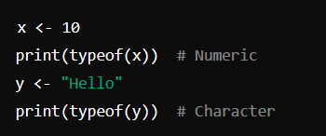
Data Types in R
Common Data Types:
Numeric: For numbers (e.g., integers, doubles).
Character: For text values or strings.
Logical: TRUE or FALSE values.
Factor: For categorical data, like gender (male/female) or grades (A/B/C).
Checking Data Types:

Slide 4
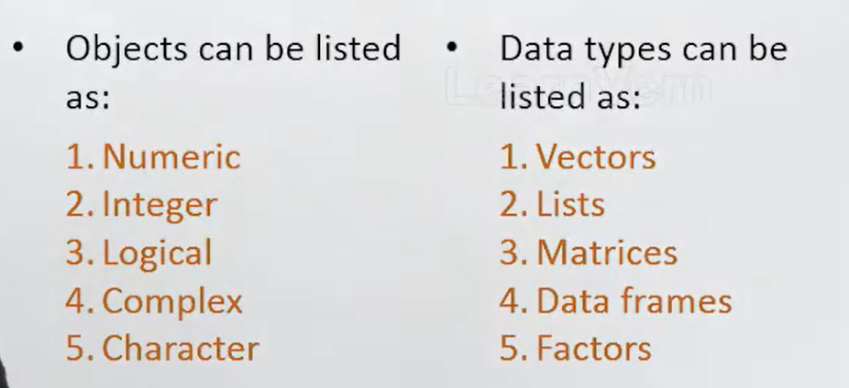

Slide 5
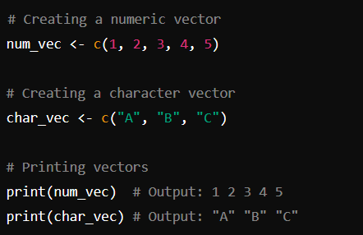
A vector is a collection of elements of the same type.

Slide 6
> x=30
> print(x)
[1] 30
> typeof(x)
[1] "double"
> is.numeric(x)
[1] TRUE
> as.numeric(X)

Slide 7
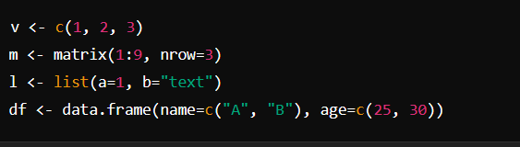
Objects in R
Vectors: A one-dimensional array of elements (e.g., numbers, characters).
Matrices: A two-dimensional array where all elements are of the same type.
Lists: A collection of objects, which can be of different types (e.g., a combination of numbers, strings, and even data frames).
Factors: Used to store categorical data and its levels (e.g., levels for gender: Male, Female).
Data Frames: A table-like structure, similar to a spreadsheet, used for storing data in rows and columns.

Slide 8
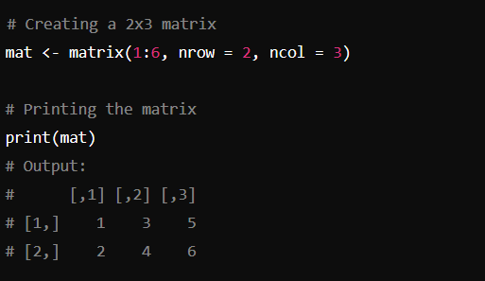
matrices
A matrix is a 2-dimensional array where all elements are of the same type.

Slide 9
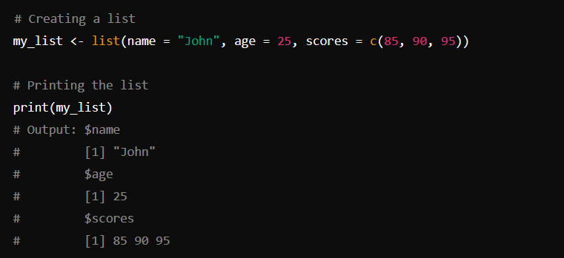
Lists
A list can hold elements of different types.

Slide 10
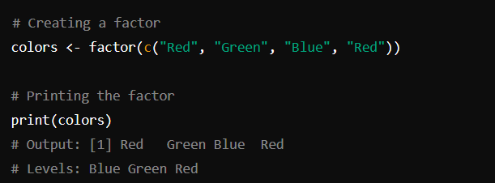
Factors
Factors are used for categorical data.(Categorised)

Slide 11
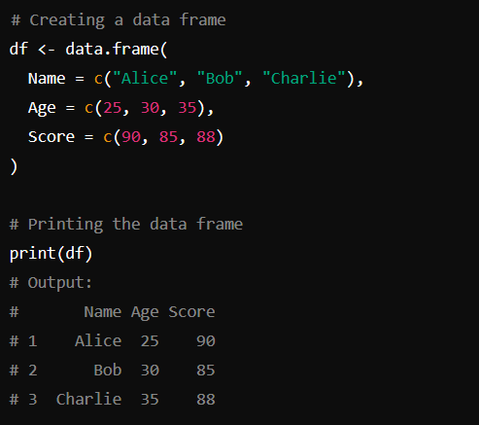
Data frames
A data frame is like a table with rows and columns.

Slide 12
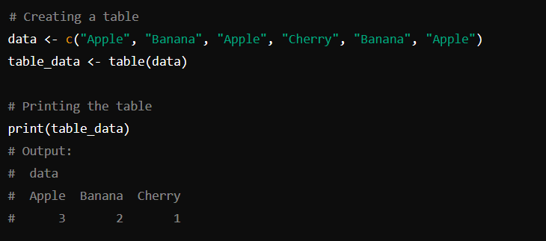
Tables
Tables summarize categorical data.

Slide 13
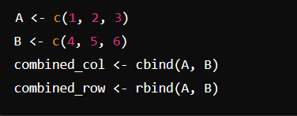
Combining Data (cbind & rbind)
cbind(): Combines two or more vectors, matrices, or data frames column-wise.
rbind(): Combines data row-wise, useful for adding new observations.
Example:

Slide 14

Reading and Writing Data
Reading Data: Functions like read.csv() and read.table() are commonly used to import data into R.
Writing Data: You can save your data as CSV or other formats using functions like write.csv() or write.table().
Example:

Slide 15
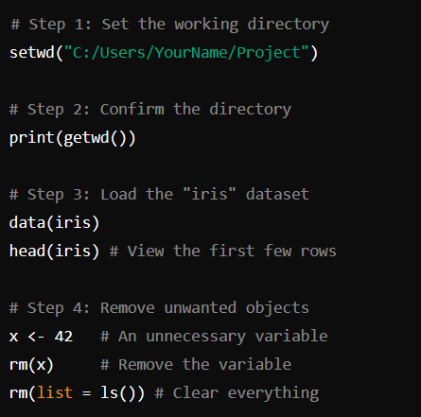
Working Directories

Slide 16
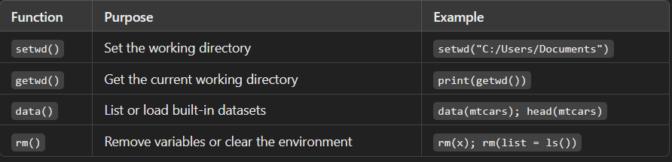

Slide 17
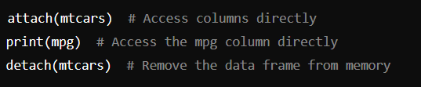
Attaching and Detaching Data
Attaching Data: Use attach() to add the columns of a data frame to the R search path, allowing direct access to the column names.
Detaching Data: Use detach() to remove the data frame from the search path.

Slide 18

Reading Data from Console
You can read data interactively from the console using the readline() function, which is useful for simple user input.

Slide 19
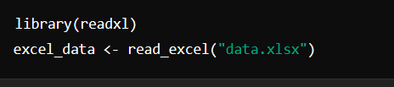
Loading Data from Different Sources
Reading from CSV: read.csv() loads CSV files.
Reading from Excel: You can use the readxl package to load Excel files.

Slide 20
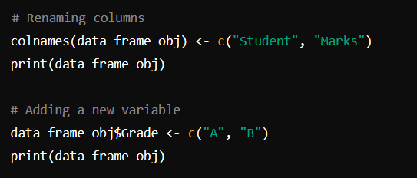
Data Preprocessing in R
Renaming Variables:
names(df)[1] <- "new_name"
# Renames the first column
Adding a New Variable:
df$new_column <- df$age * 2
# Adds a new column

Slide 21
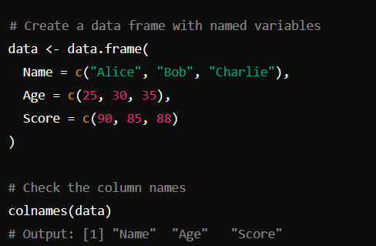
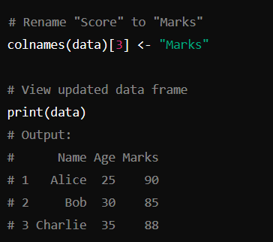

Slide 22
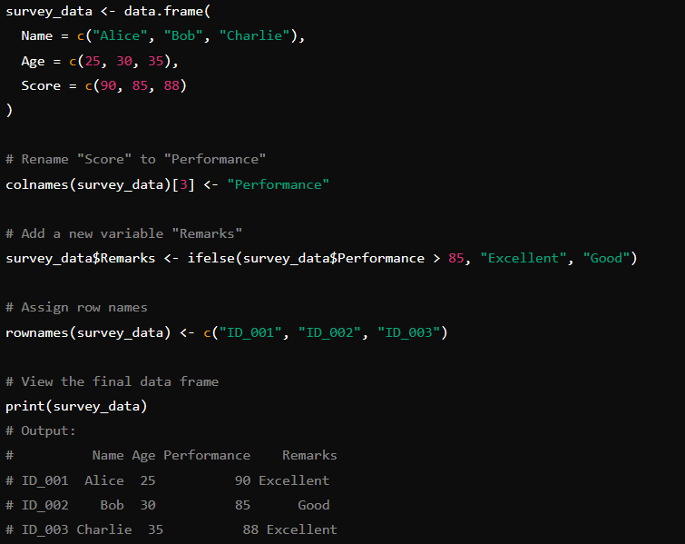

Slide 23
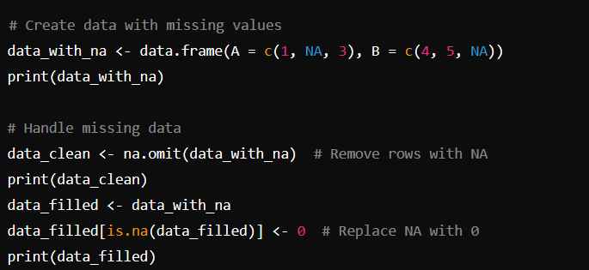
Handling Missing Data
Checking for NA: is.na()
Replacing Missing Values:
df[is.na(df)] <- mean(df, na.rm=TRUE)

Slide 24
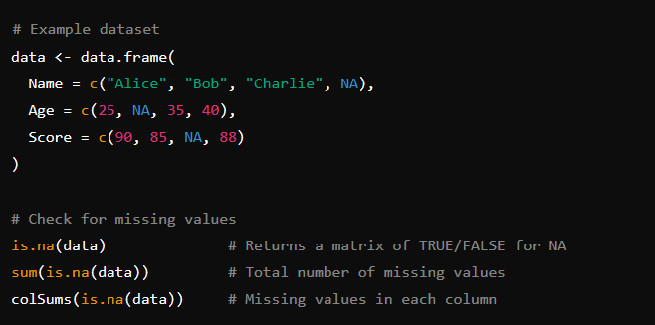
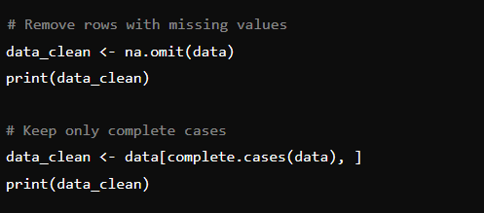
Handling missing data

Slide 25
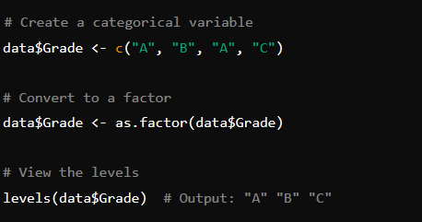
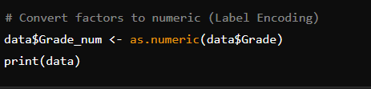
Dealing with Categorical Data
Factors: Use factor() to convert categorical data into factors, which are used for statistical modeling.

Slide 26
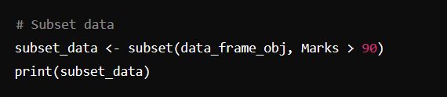
Data Reduction via Subsetting
Subsetting: Extract specific rows or columns from a data frame using subset().
small_df <- subset(df, select=c("age", "name"))

Slide 27
Conclusion
Summarize key points about:
The basics of R programming.
Data types and objects in R.
How to load, manage, and preprocess data in R.

